Slide 1
Lesson 2 Activity 2
Comparing Different Ecosystems

Slide 2
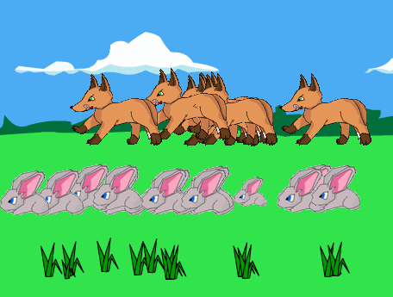
How does Sunny Meadows compare to real ecosystems?
Does the same pattern in size of organic carbon pools exist in other ecosystems?

Slide 3
Sunny Meadows Data
Organic Carbon Pools
0.1
Carnivores organic carbon
We can represent the size of each organic carbon pool with numbers
Atmosphere CO₂
2
Herbivores organic carbon
21
Soil
organic carbon
Producers organic carbon
Notes:
Here’s another way you could look at these numbers.

Slide 4
Biomass
Mr. Chopp’s class data
Organic Carbon Pools
0.1
Carnivores organic carbon
Atmosphere CO₂
2
Herbivores organic carbon
21
Soil
organic carbon
Producers organic carbon
Notes:
Here’s another way you could look at these numbers.

Slide 5
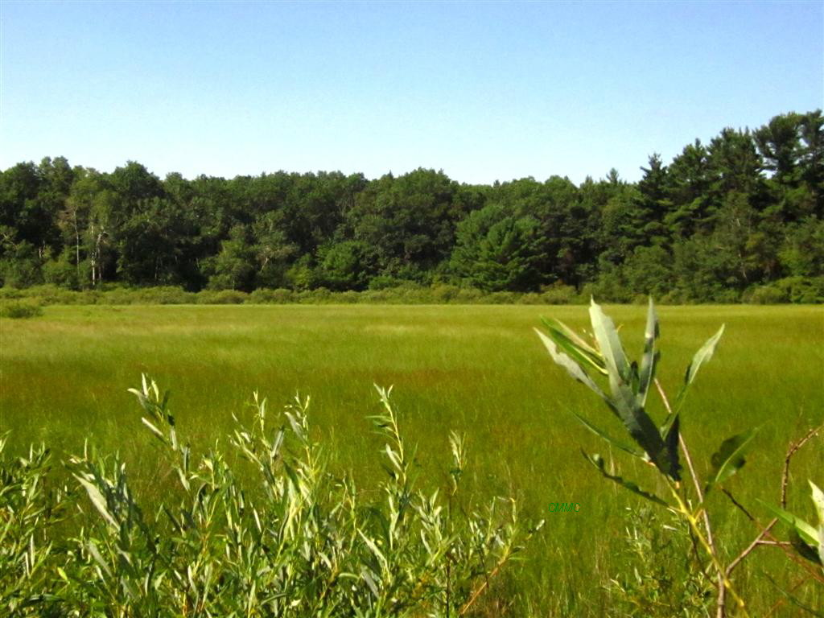
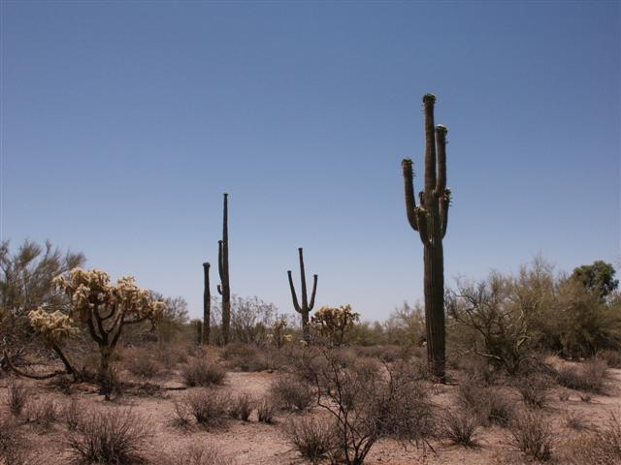
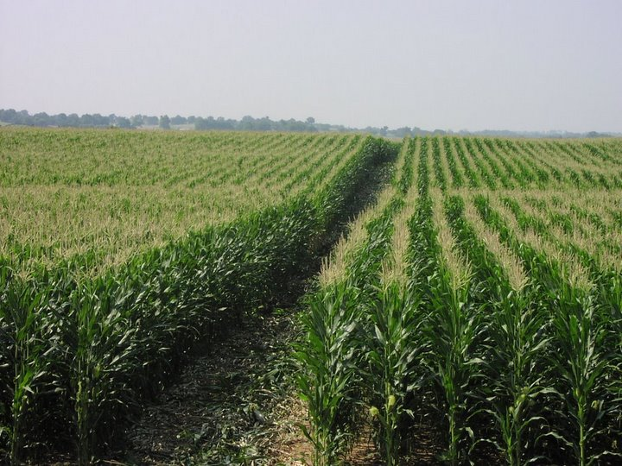
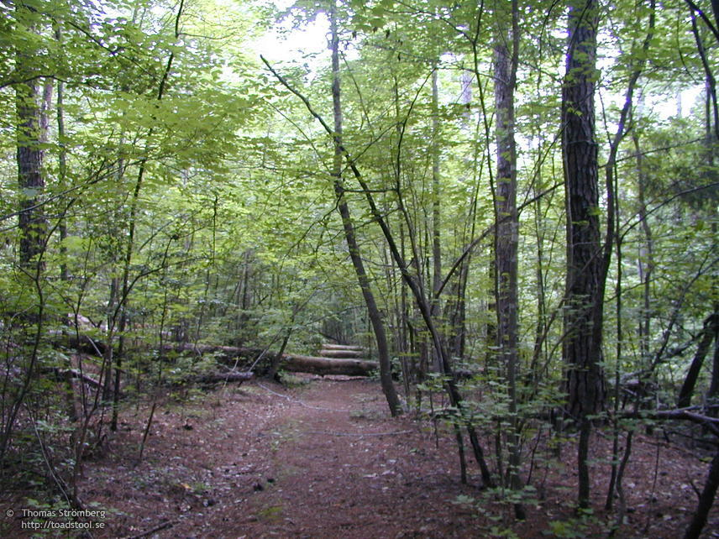
Let’s look at organic carbon pools in real ecosystems
Prairie
Desert
Cornfield
Forest

Slide 6
Which ecosystem do you think has the most organic carbon?
Prairie
Desert
Notes:
On the left is a forest marsh ecosystem found in the Midwest of the United States, in Michigan. On the right is a desert ecosystem found in the southwest of the United States, in Arizona.
Desert photo: http://smolderingink.com/blog/?p=184
Marsh photo: http://plantsamazeme.blogspot.com/2011/09/newaygo.html

Slide 7
Notice the pattern of organic carbon pool sizes
0.1
Carnivores organic carbon
Atmosphere CO₂
2
Herbivores organic carbon
190
30
Prairie
Soil
organic carbon
Producers organic carbon
Notes:
On the left is a forest marsh ecosystem found in the Midwest of the United States, in Michigan. On the right is a desert ecosystem found in the southwest of the United States, in Arizona.
Desert photo: http://smolderingink.com/blog/?p=184
Marsh photo: http://plantsamazeme.blogspot.com/2011/09/newaygo.html
Herbivore and Carnivore numbers are estimates. Soil organic carbon and producers were multiplied by 10 so they are easier to interpret and compare with smaller numbers.
Schlesinger “An Analysis of Global Change” pg 142. Mean plant biomass (kg C m-2)
Desert 0.3
Temperate forest 8
Prairie 3
Cultivated land 1.4
Tropical forest 10.4
Schlesinger pg 157, Soil carbon (kg C m-2)
Temperate forest 11.8
Desert 5.6
Prairie 19.2
Cultivate 12.7
Tropical forest 10.4

Slide 8
Notice the pattern of organic carbon pool sizes
0.02
Carnivores organic carbon
Atmosphere CO₂
0.4
Herbivores organic carbon
56
3
Soil
Organic Carbon
Producers organic carbon
Desert
Notes:
On the left is a forest marsh ecosystem found in the Midwest of the United States, in Michigan. On the right is a desert ecosystem found in the southwest of the United States, in Arizona.
Desert photo: http://smolderingink.com/blog/?p=184
Marsh photo: http://plantsamazeme.blogspot.com/2011/09/newaygo.html
Herbivore and Carnivore numbers are estimates. Soil organic carbon and producers were multiplied by 10 so they are easier to interpret and compare with smaller numbers.
Schlesinger “An Analysis of Global Change” pg 142. Mean plant biomass (kg C m-2)
Desert 0.3
Temperate forest 8
Prairie 3
Cultivated land 1.4
Tropical forest 10.4
Schlesinger pg 157, Soil carbon (kg C m-2)
Temperate forest 11.8
Desert 5.6
Prairie 19.2
Cultivate 12.7
Tropical forest 10.4

Slide 9
Desert
Prairie
0.1
0.02
0.1
Carnivores organic carbon
Carnivores organic carbon
Atmosphere CO₂
Atmosphere CO₂
2
0.4
2
Herbivores organic carbon
Herbivores organic carbon
30
3
190
30
56
190
Soil
Organic Carbon
Producers organic carbon
Soil
Organic Carbon
Producers organic carbon
Notes:
On the left is a forest marsh ecosystem found in the Midwest of the United States, in Michigan. On the right is a desert ecosystem found in the southwest of the United States, in Arizona.
Desert photo: http://smolderingink.com/blog/?p=184
Marsh photo: http://plantsamazeme.blogspot.com/2011/09/newaygo.html
Herbivore and Carnivore numbers are estimates. Soil organic carbon and producers were multiplied by 10 so they are easier to interpret and compare with smaller numbers.
Schlesinger “An Analysis of Global Change” pg 142. Mean plant biomass (kg C m-2)
Desert 0.3
Temperate forest 8
Prairie 3
Cultivated land 1.4
Tropical forest 10.4
Schlesinger pg 157, Soil carbon (kg C m-2)
Temperate forest 11.8
Desert 5.6
Prairie 19.2
Cultivate 12.7
Tropical forest 10.4

Slide 10
Which ecosystem do you think has the most organic carbon?
Cornfield
Forest
Notes:
On the left is a corn field. On the right is a forest.
Farm photo:http://blog.risingbricsam.com/?attachment_id=1441
Forest photo: http://www.fcps.edu/islandcreekes/ecology/forest.htm

Slide 11
Notice the pattern of organic carbon pool sizes
0.1
Carnivores organic carbon
Atmosphere CO₂
1
Herbivores organic carbon
127
14
Cornfield
Soil
Organic Carbon
Producers organic carbon
Notes:
On the left is a corn field. On the right is a forest.
Farm photo:http://blog.risingbricsam.com/?attachment_id=1441
Forest photo: http://www.fcps.edu/islandcreekes/ecology/forest.htm
Herbivore and Carnivore numbers are estimates. Soil organic carbon and producers were multiplied by 10 so they are easier to interpret and compare with smaller numbers.
Schlesinger “An Analysis of Global Change” pg 142. Mean plant biomass (kg C m-2)
Desert 0.3
Temperate forest 8
Prairie 3
Cultivated land 1.4
Tropical forest 10.4
Schlesinger pg 157, Soil carbon (kg C m-2)
Temperate forest 11.8
Desert 5.6
Prairie 19.2
Cultivate 12.7
Tropical forest 10.4

Slide 12
Notice the pattern of organic carbon pool sizes
0.7
Carnivores organic carbon
Atmosphere CO₂
9
Herbivores organic carbon
118
80
Soil
Organic Carbon
Producers organic carbon
Forest
Notes:
On the left is a corn field. On the right is a forest.
Farm photo:http://blog.risingbricsam.com/?attachment_id=1441
Forest photo: http://www.fcps.edu/islandcreekes/ecology/forest.htm
Herbivore and Carnivore numbers are estimates. Soil organic carbon and producers were multiplied by 10 so they are easier to interpret and compare with smaller numbers.
Schlesinger “An Analysis of Global Change” pg 142. Mean plant biomass (kg C m-2)
Desert 0.3
Temperate forest 8
Prairie 3
Cultivated land 1.4
Tropical forest 10.4
Schlesinger pg 157, Soil carbon (kg C m-2)
Temperate forest 11.8
Desert 5.6
Prairie 19.2
Cultivate 12.7
Tropical forest 10.4

Slide 13
Forest
Cornfield
0.1
0.7
0.1
Carnivores organic carbon
Carnivores organic carbon
Atmosphere CO₂
Atmosphere CO₂
1
9
1
Herbivores organic carbon
Herbivores organic carbon
14
80
127
14
118
127
Soil
Organic Carbon
Producers organic carbon
Soil
Organic Carbon
Producers organic carbon
Notes:
On the left is a corn field. On the right is a forest.
Farm photo:http://blog.risingbricsam.com/?attachment_id=1441
Forest photo: http://www.fcps.edu/islandcreekes/ecology/forest.htm
Herbivore and Carnivore numbers are estimates. Soil organic carbon and producers were multiplied by 10 so they are easier to interpret and compare with smaller numbers.
Schlesinger “An Analysis of Global Change” pg 142. Mean plant biomass (kg C m-2)
Desert 0.3
Temperate forest 8
Prairie 3
Cultivated land 1.4
Tropical forest 10.4
Schlesinger pg 157, Soil carbon (kg C m-2)
Temperate forest 11.8
Desert 5.6
Prairie 19.2
Cultivate 12.7
Tropical forest 10.4

Slide 14
Desert
Prairie
Forest
Cornfield
0.02
0.1
0.7
0.1
Carnivores organic carbon
Carnivores organic carbon
Carnivores organic carbon
Carnivores organic carbon
Atmosphere CO₂
Atmosphere CO₂
2
Atmosphere CO₂
9
Atmosphere CO₂
1
0.4
Herbivores organic carbon
Herbivores organic carbon
Herbivores organic carbon
Herbivores organic carbon
3
190
30
118
80
127
14
56
Soil
Organic Carbon
Producers organic carbon
Soil
Organic Carbon
Producers organic carbon
Soil
Organic Carbon
Producers organic carbon
Soil
Organic Carbon
Producers organic carbon
Notes:
On the left is a corn field. On the right is a forest.
Farm photo:http://blog.risingbricsam.com/?attachment_id=1441
Forest photo: http://www.fcps.edu/islandcreekes/ecology/forest.htm
Herbivore and Carnivore numbers are estimates. Soil organic carbon and producers were multiplied by 10 so they are easier to interpret and compare with smaller numbers.
Schlesinger “An Analysis of Global Change” pg 142. Mean plant biomass (kg C m-2)
Desert 0.3
Temperate forest 8
Prairie 3
Cultivated land 1.4
Tropical forest 10.4
Schlesinger pg 157, Soil carbon (kg C m-2)
Temperate forest 11.8
Desert 5.6
Prairie 19.2
Cultivate 12.7
Tropical forest 10.4

Slide 15
What pattern did you notice in all of the ecosystems?
Soil is largest pool organic carbon
Producers are bigger than herbivores
Herbivores are bigger than consumers
Consumers are the smallest pool of organic carbon

Slide 16
An unanswered question:
Why does this pattern exist in ecosystems?
What are the processes that cause this pattern?

